Slide 1


Bike Store Data Analysis Project
SQL Analysis of the BikeStores Database
Team Members:
Abhijith S D
Arvind C R
Ayyasamy S
Gurumurthy Kalyanpur Viswanathaiah
Manjunath

Slide 2
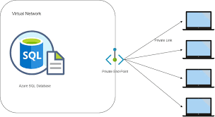


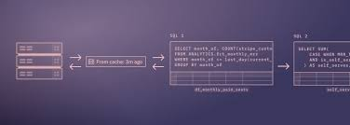

Project Overview and Setup
Objective:
- To provide actionable insights derived from the bike store dataset.
- To assist in making informed business decisions based on data analysis.
Dataset Overview:
- Scope - Data Import and Schema Overview, Data Analysis Using SQL (Descriptive Statistics, Data Cleaning, Aggregation and Grouping, Joins and Relationships, Use of Sub-queries, CTEs and Advanced Functions,), Insights and Conclusion.
- Dataset Includes - Brands, Categories, Customers, Order Items, Orders, Staff, Stocks and Stores details.

Slide 3
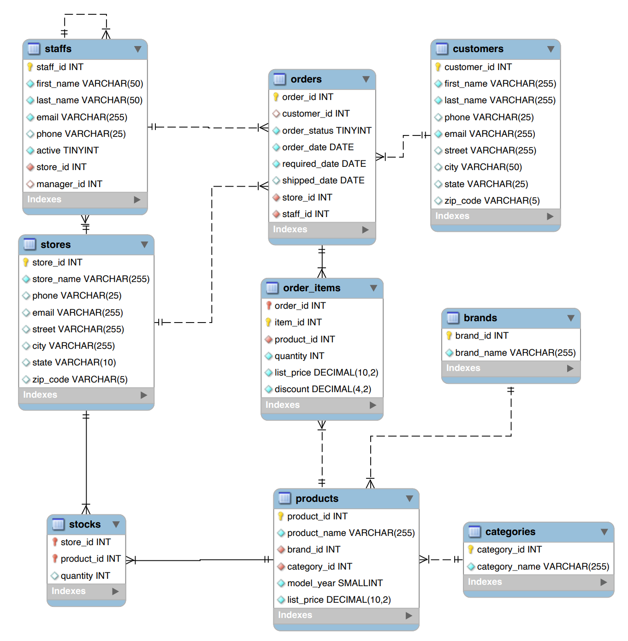
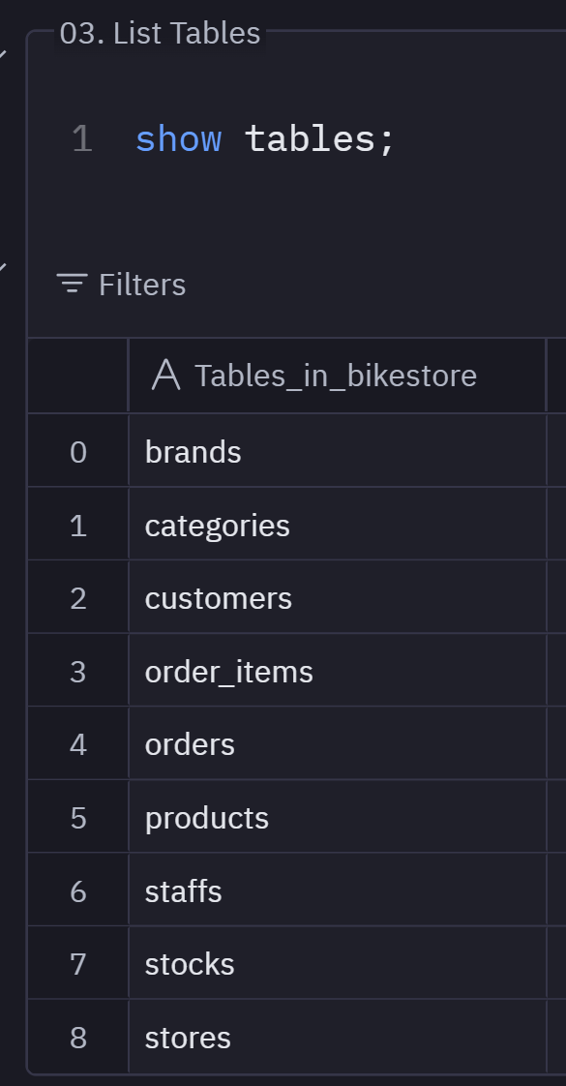
Entity Relationship Diagram
Tables:

Slide 4
Customer Demographics & Purchasing Behaviour
Demographics:
- Observations - To provide actionable insights derived from the bike store dataset.
- Recommendations
- To assist in making informed business decisions based on data analysis.
Purchasing Behaviour:
- Observations - Data Import and Schema Overview, Data Analysis Using SQL (Descriptive Statistics, Data Cleaning, Aggregation and Grouping, Joins and Relationships, Use of Sub-queries, CTEs and Advanced Functions,), Insights and Conclusion.
- Recommendations - Brands, Categories, Customers, Order Items, Orders, Staff, Stocks and Stores details.

Slide 5
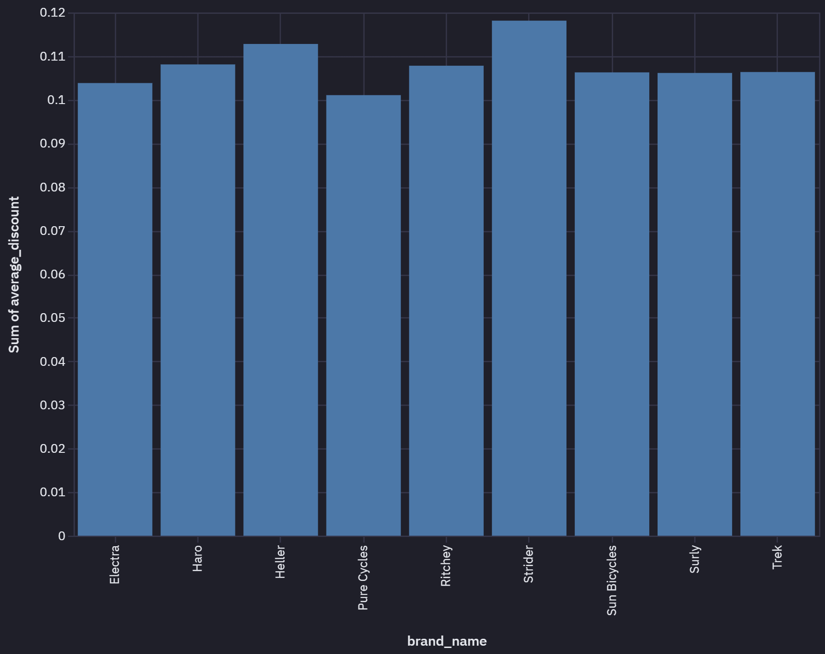
Sales Performance by Category and Brand
Category:
- Observations - To provide actionable insights derived from the bike store dataset.
- Recommendations
- To assist in making informed business decisions based on data analysis.
Brand:
- Observations - Data Import and Schema Overview, Data Analysis Using SQL (Descriptive Statistics, Data Cleaning, Aggregation and Grouping, Joins and Relationships, Use of Sub-queries, CTEs and Advanced Functions,), Insights and Conclusion.
- Recommendations - Brands, Categories, Customers, Order Items, Orders, Staff, Stocks and Stores details.

Slide 6
Sales Performance by Category and Brand
Category:
- Observations - To provide actionable insights derived from the bike store dataset.
- Recommendations
- To assist in making informed business decisions based on data analysis.
Brand:
- Observations - Data Import and Schema Overview, Data Analysis Using SQL (Descriptive Statistics, Data Cleaning, Aggregation and Grouping, Joins and Relationships, Use of Sub-queries, CTEs and Advanced Functions,), Insights and Conclusion.
- Recommendations - Brands, Categories, Customers, Order Items, Orders, Staff, Stocks and Stores details.

Slide 7
Inventory and Stock Management
Inventory:
- Observations - To provide actionable insights derived from the bike store dataset.
- Recommendations
- To assist in making informed business decisions based on data analysis.
Stock Management:
- Observations - Data Import and Schema Overview, Data Analysis Using SQL (Descriptive Statistics, Data Cleaning, Aggregation and Grouping, Joins and Relationships, Use of Sub-queries, CTEs and Advanced Functions,), Insights and Conclusion.
- Recommendations - Brands, Categories, Customers, Order Items, Orders, Staff, Stocks and Stores details.

Slide 8
Store Performance Comparison
Revenue:
- Observations - To provide actionable insights derived from the bike store dataset.
- Recommendations
- To assist in making informed business decisions based on data analysis.
Staff Management:
- Observations - Data Import and Schema Overview, Data Analysis Using SQL (Descriptive Statistics, Data Cleaning, Aggregation and Grouping, Joins and Relationships, Use of Sub-queries, CTEs and Advanced Functions,), Insights and Conclusion.
- Recommendations - Brands, Categories, Customers, Order Items, Orders, Staff, Stocks and Stores details.

Slide 9
Store Performance Comparison
Revenue:
- Observations - To provide actionable insights derived from the bike store dataset.
- Recommendations
- To assist in making informed business decisions based on data analysis.
Staff Management:
- Observations - Data
- Recommendations - Brands, Categories, Customers, Order Items, Orders, Staff, Stocks and Stores details.
Order Fulfilment and Delivery:
- Observations - Data
- Recommendations - Brands, Categories, Customers, Order Items, Orders, Staff, Stocks and Stores details.

Slide 10
Trend and Seasonality Effect
Historical Sales Trend:
- Observations - To provide actionable insights derived from the bike store dataset.
- Recommendations
- To assist in making informed business decisions based on data analysis.
Seasonality Effect:
- Observations - Data
- Recommendations - Brands, Categories, Customers, Order Items, Orders, Staff, Stocks and Stores details.

Slide 11
Summary on Insights and Recommendations
Inventory Strategies:
Implement automated alerts for low stock levels.
Analyze sales trends for better demand forecasting.
Customer Engagement:
Develop loyalty programs for top customers.
Personalized marketing based on purchasing behavior.
Staff Development:
Provide training for staff in high-performing stores.
Reassess staffing needs based on store performance.
Data Quality Improvement:
Encourage capturing complete customer information (e.g., phone numbers).
Address data gaps in shipping dates for accurate delivery analysis.
Insights:
- Observations - To provide actionable insights derived from the bike store dataset.
- Recommendations
- To assist in making informed business decisions based on data analysis.
Recommendations:
- Observations - Data
- Recommendations - Brands, Categories, Customers, Order Items, Orders, Staff, Stocks and Stores details.
Further Analysis:
Deep dive into seasonal sales trends.
Customer segmentation analysis.
Product return and refund patterns.
Business Actions:
Enhance product line based on customer preferences.
Optimize supply chain for faster deliveries.
Data Quality Improvement:
Collect missing data (e.g., phone numbers, shipping dates).
Ensure data validation in future data collection processes.

Slide 12
Conclusion
Insights:
- Observations - To provide actionable insights derived from the bike store dataset.
- Recommendations
- To assist in making informed business decisions based on data analysis.
Recommendations:
- Observations - Data
- Recommendations - Brands, Categories, Customers, Order Items, Orders, Staff, Stocks and Stores details.
Key Findings:
Top Products: Trek Slash 8 27.5 - 2016 is the highest revenue-generating product.
Order Statuses: Found that 3% of orders are rejected, indicating an area for improvement.
Customer Behavior: High concentration of sales among top customers.
Inventory Management: Some products have critically low stock levels.
Staff Allocation: Baldwin Bikes store appears understaffed given its high sales volume.
Conclusions:
Inventory: Need to replenish low-stock items promptly.
Marketing: Opportunity to expand offerings for underrepresented brands.
Staffing: Consider reallocating staff to balance workload and improve customer service.

Slide 13
Q&A

Slide 14
Appendix

Slide 15
Technical Details on Project Setup
Environment Setup:
Connected to Azure Database for remote access
Azure Database Connection details:
Host: group3.mysql.database.azure.com
Port: 3306
User: group3
Project Directory:
Created a dedicated directory for the project files in GitHUB. Included SQL scripts and data files.
Data Import:
Loaded the provided schema and data into the MySQL database.
Ensured all tables and relationships were correctly established.

Slide 16
Data Cleaning
Identified Issues:
Missing phone numbers in customers and staffs tables.
NULL values in shipped_date in orders table.
Actions taken:
Decided to retain entries with missing phone numbers to preserve data integrity.
Noted the missing shipped_date values for consideration in shipping time analysis.
Rationale:
Retaining records ensures a comprehensive analysis.
Missing values can inform about data collection processes and areas for improvement.

Slide 17
Use of Aggregates and Joins
Identified Issues:
Missing phone numbers in customers and staffs tables.
NULL values in shipped_date in orders table.
Actions taken:
Decided to retain entries with missing phone numbers to preserve data integrity.
Noted the missing shipped_date values for consideration in shipping time analysis.
Rationale:
Retaining records ensures a comprehensive analysis.
Missing values can inform about data collection processes and areas for improvement.

Slide 18
Use of several Sub-Queries and CTEs
Identifying Low Stock Products:

Slide 19
Use of Advance SQL Functions
Calculating Running Total of Sale
Year-over-Year Sales Growth:

Slide 20
Interesting queries
-- Identify top 5 products by total sales
SELECT
p.product_name,
SUM(oi.quantity * oi.list_price * (1 - oi.discount)) AS total_sales
FROM
order_items oi
JOIN products p ON oi.product_id = p.product_id
GROUP BY
p.product_name
ORDER BY
total_sales DESC
LIMIT 5;
Findings:
The top-selling product is Trek Slash 8 27.5 - 2016, generating the highest revenue.
Indicates high customer preference, suggesting a focus on inventory and promotion for this product.

